Slide 1

Fiscal Patriots Dashboard
Follow the Money
Trust The Recipient
By: Khaled Alkurd, Nikita Chandrasing, Mariam Debas, Pranavi Doodala, Andy Yaro George Mason University Costello College of Business
Fiscal Patriots | AGA Datathon 2026
Notes:
Pranavi
Good afternoon, we are the Fiscal Patriots! Addressing use case 2:
Promote Financial Literacy: Visualizing Government Expenditures
Challenge: Develop innovative and interactive visualizations using data from sources like FiscalData.Treasury.gov and usaspending.gov to make government spending more understandable for the public.
Goal/Objective: Promote financial literacy and increase engagement with government-focused datasets.

Slide 2




Meet The Fiscal Patriots
Khaled Alkurd
Team Lead
Pranavi Doodala
ML Lead
Mariam Debas
Visualization Lead
• Forensic Accounting • Accounting Analytics • Python • SQL • R • Alteryx • Tableau
• Business Analytics
• Data Science • Python • R
• Accounting
• Data Analytics • Tableau • R ​
Nikita Chandrasing
Research Lead
[Add photo]
[Add photo]
Andy Yaro
Documentation Lead
Business Analytics
Python
R
SQL
Cybersecurity Engineering
Python
Git / Github
Technical Writing
Fiscal Patriots | AGA Datathon 2026
Notes:
Let's meet our small but mighty team!

Slide 3
Government Data is Powerful
The Data
The Problem
The Solution
We Connected the Dots
74M USAspending records processed
57,448 audited entities analyzed
3 federal systems integrated
Trust Can't Be Verified
3 systems, 1 identifier, 0 integration
Audit failures don't reduce funding
$1.09T to Entities with Severe Audit Failures
33,780 excluded entities traceable, none auto-blocked
We Built the Tools
42,233 entities matches & scored
Taxpayer Protection Score (0-100)
Predictive risk model
Citizens can finally see where tax dollars go
But they can't verify which entities to trust
Until now
Fiscal Patriots | AGA Datathon 2026
Source: USAspending.gov (FY2019-2024), Federal Audit Clearinghouse (FY2016-Present), SAM.gov Public Extract 25361 (Dec 27, 2025)
Notes:
Khaled

Slide 4
A Unified View of Federal Accountability
Three federal systems connected by one identifier. Separately, open data. Together, accountability.
USAspending.gov
Federal Audit Clearinghouse
SAM.gov
Federal financial assistance (grants, loans, subsidies)
74M records FY2019-2024
Tracks who receives federal funds
Primary spending data source
Managed by U.S. Treasury
Single audit findings and compliance
57,448 entities FY2016-2024
Required for entities receiving $750k+
Identifies control failures
332,417 total findings analyzed
Excluded & debarred entities
Governmentwide exclusions
167,000 records
33,780 entities with UEI
Public Extract V2 (Dec 27, 2025)
Add data scope to this slide
UEI is the key. Connecting spending, audits, and exclusions
Connected by UEI Unique Entity Identifier
Powered by: Alteryx (Data Engineering), Tableau (Visuals), Python (ML)
Fiscal Patriots | AGA Datathon 2026
Source: USAspending.gov (FY2019-2024), Federal Audit Clearinghouse (FY2016-2024), SAM.gov Public Extract 25361 (Dec 27, 2025)
Notes:
Khaled

Slide 5
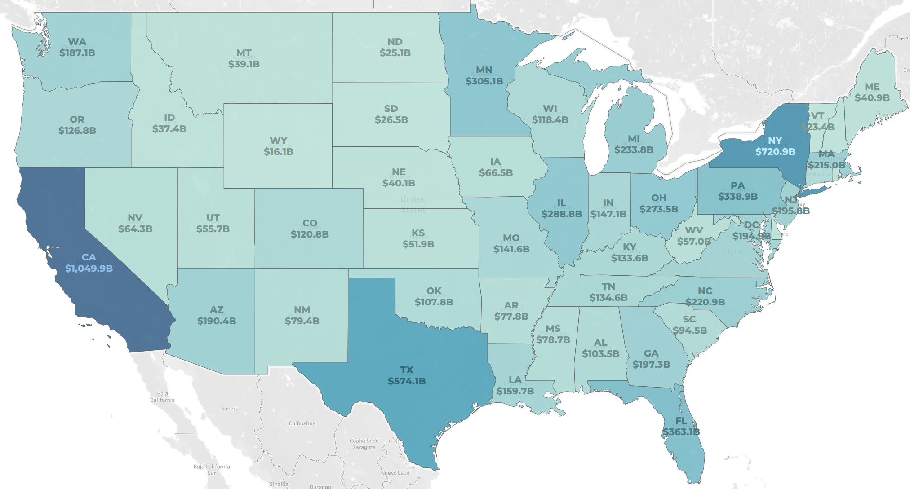
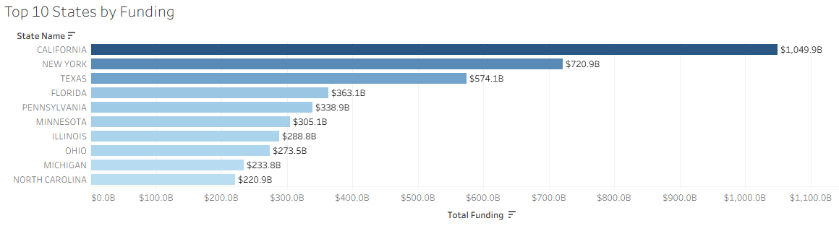
Where Does Federal Funding Go?
Half of all federal assistance awards flow to just 10 states. This is where the money lands.
Funding Snapshot
$8.58 Trillion Federal Financial Assistance
$4.37T to Top 10 States (51%)
$1.05T to California Alone (12%)
181,922 Recipients Tracked
Total Federal Awards
You can see where the money goes. But can you trust who receives it?
Fiscal Patriots | AGA Datathon 2026
Source: USAspending.gov (FY2019-2024)
Notes:
Mariam -
Over the past six years, the federal government has distributed approximately $8.58 T in financial assistance to almost 182,000 recipients across the country.
But here's what's striking - this map shows funding isn't distributed evenly. Half of all federal assistance - $4.37 trillion - flows to just 10 states. California alone receives over $1 trillion, which is 12% of all federal funding.
Now, when we look at this map, we can see exactly where the money lands. The darker blue states are receiving the most funding. But here's the critical question..." -pause- "...you can see where the money goes, but can you trust who receives it

Slide 6
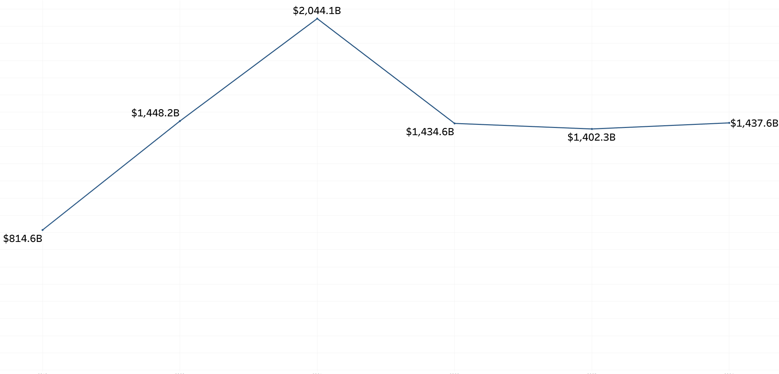
Federal Financial Assistance Over Time
COVID drove funding to record highs. The baseline nearly doubled. Did accountability keep pace?
Trend Snapshot
$2.04 Trillion FY2021 Peak (COVID)
$1.4 Trillion Stabilized by FY2022
3 Years Flat FY2022-2024
$8.58T Total Over 6 Years
+76% in 5 Years
2019
2020
2021
2022
2023
2024
Spending up 76%. Oversight unchanged.
Fiscal Patriots | AGA Datathon 2026
Source: USAspending.gov (FY2019-2024)
Notes:
Mariam -
Now let's look at what happened to federal spending over the past six years. In 2021, at the height of COVID, federal assistance hit an all-time high of $2.04 trillion - that's the spike you see here. PPP loans, CARES Act funding, enhanced unemployment - money was flowing out at unprecedented speed. By 2022, spending stabilized at around $1.4 trillion, and it's stayed flat through 2024.
But here's what should concern every taxpayer …"spending increased 76% in just five years. The federal government nearly doubled the baseline of assistance it provides"
Gap: But oversight? The accountability systems? They didn't change at all. We're still using the same frameworks, the same controls, the same manual processes that existed when spending was half this amount.
Implication: During COVID, agencies had to move fast - speed over scrutiny. Billions went out the door in weeks. And now, years later, we're still finding entities that received massive funding despite having documented control failures

Slide 7
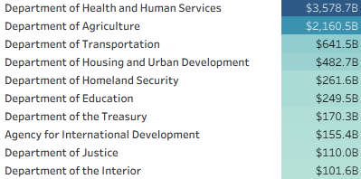
How Is Funding Concentrated?
Just 10 agencies are responsible for 92% of all federal financial assistance to recipients nationwide.
Concentration Snapshot
$3.58 Trillion to HHS Alone (42%) (Primarily Medicare/Medicaid)
$5.74T to Top 2 Agencies (67%)
$7.9T to Top 10 Agencies (92%)
$670B to 33 Other Agencies (8%)
Top 10 Agencies by Federal Funding (FY2019-2024)
33 Other Agencies: 8% ($670B)
Top 10 Agencies: 92% ($7.9T)
67% of federal dollars flow through just two agencies. Who's watching where it goes?
Fiscal Patriots | AGA Datathon 2026
Source: USAspending.gov (FY2019-2024)
Notes:
Mariam
Transition - "Now let's look at where all this money is concentrated by agency."
Just 10 agencies are responsible for 92% of all federal financial assistance to recipients nationwide. That's $7.9 trillion out of $8.58 trillion. But it's even more concentrated than that."
The Department of Health and Human Services alone manages $3.58 trillion - that's 42% of all federal funding. HHS is nearly half of all federal assistance."
"When you add USDA - the Department of Agriculture - these two agencies control 67% of federal dollars. Two-thirds of all taxpayer money flows through just two agencies."
You can see it in this pie chart - the top 10 are the blue segments representing 92% of funding. That tiny sliver? That's 33 other federal agencies sharing just 8% - $670 billion."
Implication: Here's why this matters..." [pause, gesture to bottom callout] "...67% of federal dollars flow through just two agencies. So the question becomes: who's watching where it goes?"
Set up the concern: "When funding is this concentrated, accountability failures at HHS or USDA don't just affect one program - they affect trillions in taxpayer dollars."

Slide 8
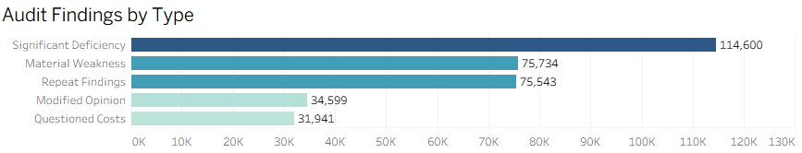
What the Audits Reveal
Cumulative Audit Findings (FY2016-2024) reveal a chronic pattern of over 332,417 findings of control failures and financial mismanagement.
Highest severity: Indicates broken internal controls
Federal Audit Snapshot
57,448 Entities Audited
332,417 Total Findings FY2016-2024
Average of 5.8 Findings per Entity
75,734 Material Weaknesses
What These Findings Mean
Significant Deficiency | Material Weakness | Repeat Findings | Modified Opinion | Questioned Costs
Notable control weakness | Severe control failure | Same issue year after year | Auditor couldn't fully approve | Spending flagged as improper
Audits surface the problems. But how do we measure the risk?
Fiscal Patriots | AGA Datathon 2026
Source: Federal Audit Clearinghouse (FY2016-2024)
Notes:
Federal audits from 2016-2024 uncovered over 220,000 findings across 57,448 entities, with 75,734 material weaknesses—averaging 3.8 problems per entity. The data shows five main types of control failures: significant deficiencies, material weaknesses, repeat findings, modified opinions, and questioned costs—revealing systemic issues in how federal funds are managed. But here's the critical question: audits surface the problems, but how do we measure the risk when audit coverage runs out?

Slide 9
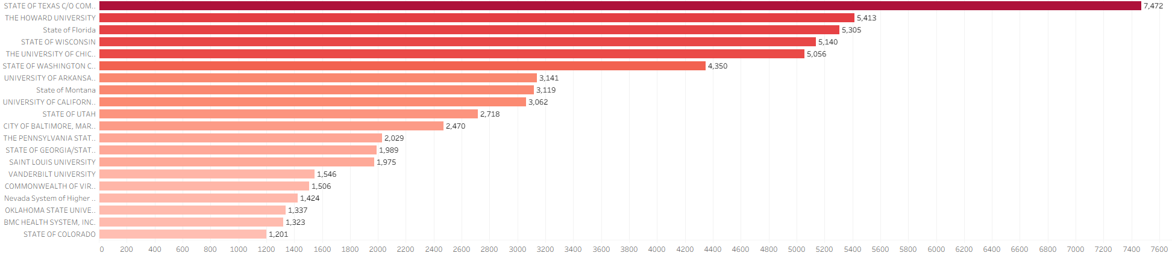
Where Risk Concentrates
A small number of entities drive most audit failures.
Concentration Snapshot
332,417 Findings
16,334 Entities with findings
Top 20 entities → 13% of findings
Top 20 average: 2,239 findings
All others average: 18 findings
Top 20 Entities by Audit Findings
20 entities. 13% of failures.
124x the average.
Fiscal Patriots | AGA Datathon 2026
Source: Federal Audit Clearinghouse (FY2016-2024)
Notes:
Risk isn't spread evenly — it's concentrated.
We analyzed over 332,000 audit findings across 16,000 entities.
Look at this chart: just 20 entities — led by Texas, Howard University, Florida, Wisconsin — account for 13% of all findings.
The Top 20 average 2,239 findings each. Everyone else? Just 18.
That's 124 times the average.
This concentration is why we built the Taxpayer Protection Score — to identify these high-risk entities before they receive more funding.

Slide 10
The Audit Health Score
Turning complex audit data into a simple 0-100 score. Making federal accountability accessible to everyone.
Score = 100 - Risk Points (capped 0-100)
Score = 100 - Risk Points (capped 0-100)
Assessment parameter
Risk Factor Rationale
Key Risk Factors
Going Concern (+25) | Auditor doubts entity can continue operating.
Material Weakness (+20) | Severe internal control failure.
Repeat Findings (+15) | Same problem year after year, the entity isn't improving.
Questioned Costs (+15) | Taxpayer dollars flagged as being used improperly.
11 total risk factors weighted by severity (see appendix)
Mitigating Factors
Low Risk Auditee (-15) | Clean audit history, proven track record.
Corrective Action Plan (-5) | Entity responded to findings with an action plan.
Risk Tiers
🔴 High Risk (0-59). Multiple audit failures
🟡 Moderate Risk (60-79). Some concerns identified
🟢 Low Risk (80-100). Minimal findings, trusted
Now let's apply this score to real federal funding data.
Fiscal Patriots | AGA Datathon 2026
Source: Federal Audit Clearinghouse (FY2016-2024) merged with USAspending.gov (FY2019-2024)
Notes:
The Taxpayer Protection Score turns complex audit data into a simple 0-100 score.
Here's how it works: We start at 100 and subtract points for risk factors.
Going Concern is the most severe — 25 points — it means auditors doubt the entity can continue operating.
Material weaknesses, repeat findings, and questioned costs add up fast.
But we also give credit back. Entities with clean track records or corrective action plans earn points back.
The result? Three clear tiers: Red for High Risk, Yellow for Moderate, Green for Low Risk.
Now let's apply this score to real federal funding data.

Slide 11
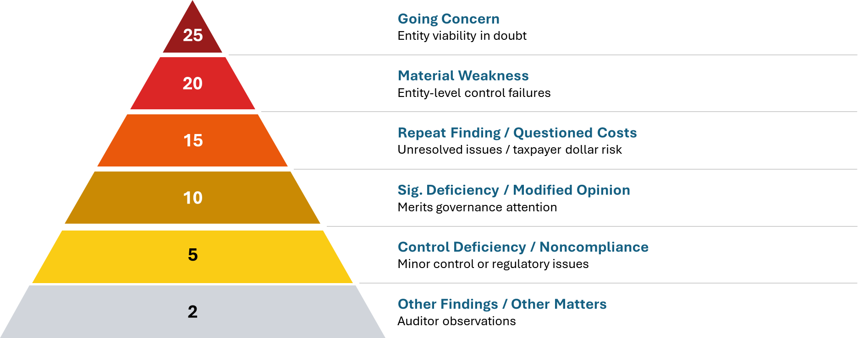
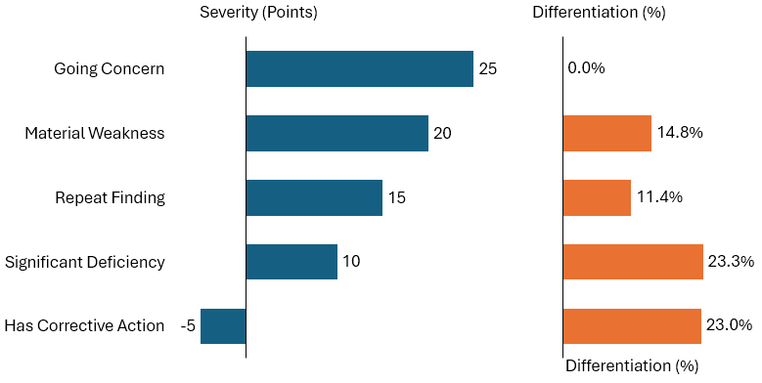
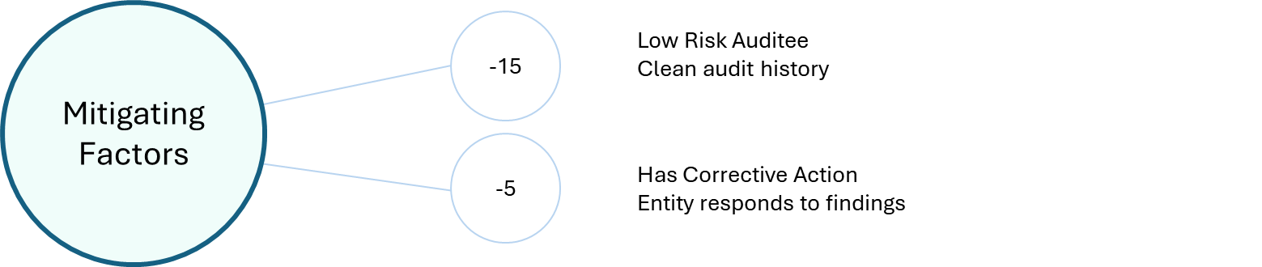
The Science Behind the Score
Federal audit standards define severity. Our model proves they predict risk.
Score = 100 - Risk Points (capped 0-100)
Legal Citation
AU-C 570
Random Forest feature importance
AU-C 265
2 CFR 200.516
AU-C 265
2 CFR 200.516
2 CFR 200 Subpart F
2 CFR 200.520
2 CFR 200.511(c)
Risk Tiers 🟢 80-100 Low Risk 🟡 60-79 Moderate Risk 🔴 0-59 High Risk
Built on Law, Proven by Math: A Transparent Standard for Federal Risk.
Fiscal Patriots | AGA Datathon 2026
Source: AU-C 265 | AU-C 570 | 2 CFR 200 Subpart F (§200.511, §200.516, §200.520) | Random Forest Model
Notes:
Our weights aren't arbitrary — they're grounded in federal audit standards.
Going Concern at the top, 25 points — that's AU-C 570, the auditor's most severe warning.
Material weaknesses, repeat findings, questioned costs — each mapped to specific CFR citations.
But here's what validates our approach: we ran a Random Forest model on the data.
The machine learning independently confirmed our weights. Going Concern, Material Weakness, Repeat Findings — the model ranked them the same way we did.
Built on law. Proven by math. A transparent standard for federal risk.

Slide 12
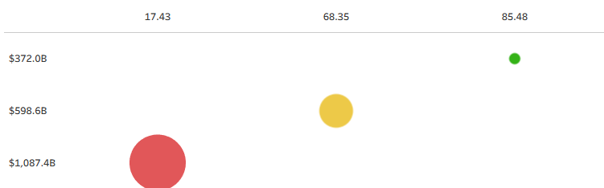
The Funding Paradox: High-Risk Entities Get 3x More
$1.09 trillion in taxpayer dollars went to recipients that auditors flagged for repeated failures.
Audit Health Score
Funding Snapshot
$1.09 Trillion to High-Risk Entities
3x More Than Low Risk
82% Funded to High & Moderate Risk Entities
42,222 audited entities receiving $2.06T in federal funding
Total Funding
Number of recipients
Audit failures don't stop the money. Neither does being banned.
Fiscal Patriots | AGA Datathon 2026
Source: Federal Audit Clearinghouse (FY2016-2024) merged with USAspending.gov (FY2019-2024)
Notes:
Nikita
"Now here's where our analysis reveals something shocking." "$1.09 trillion in taxpayer dollars went to high-risk entities - recipients that auditors flagged for repeated failures. Green dot - Compare that to low-risk entities - those with clean audit histories and proven track records. They received just $372 billion." Entities that auditors repeatedly flagged for control failures, material weaknesses, and questioned costs are receiving three times more federal funding than entities with clean records.
82% went to entities in the high or moderate risk categories. Only 18% went to proven, low-risk recipients."
The point - "This is the paradox at the heart of federal accountability. In theory, audit findings should be red flags. They should trigger enhanced scrutiny, reduced funding, or corrective action requirements."
"But in practice? Audit failures don't stop the money. There's no consequence for poor controls. No incentive for improvement. The system is actually rewarding risk instead of punishing it."
We're tracking 42,222 audited entities that received $2.06 trillion in federal funding over this period. This isn't a small sample - this is comprehensive."
The distribution: "The chart shows it clearly - the number of recipients is fairly distributed across risk tiers. But the funding? Massively skewed toward high-risk entities."

Slide 13
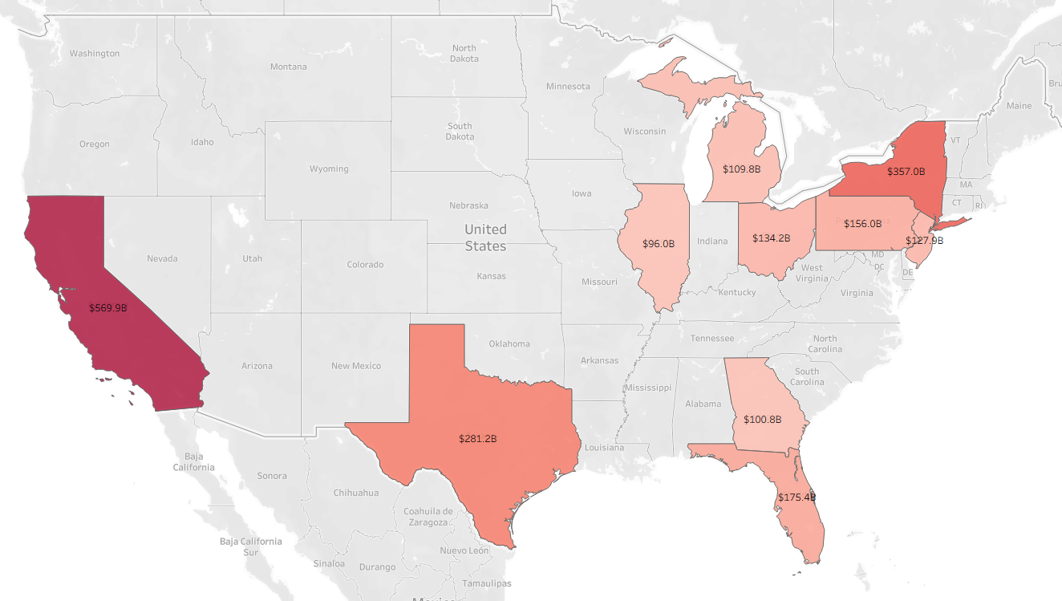
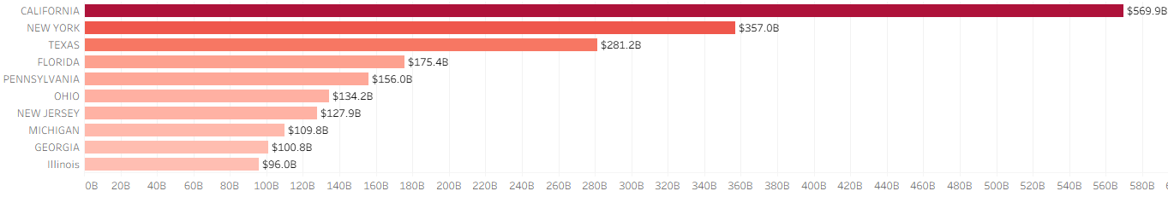
When the Score Hits Zero
The 10 largest recipients all have an Audit Health Score of 0.
Risk Snapshot
10 state governments
#1 California: $570B
Highest findings: 233 (MA)
$2.1T in expenditures
TPS = 0 (all)
Audited Federal Expenditures
Maximum risk. Maximum funding. Minimum accountability.
Fiscal Patriots | AGA Datathon 2026
Source: Federal Audit Clearinghouse Single Audit Expenditures (FY2016-2024) merged with USAspending (FY2019-2024)
Notes:
Now I want to show you the most critical situation in our analysis—what happens when a state's TPS score hits absolute zero. This means they've completely exhausted their federal audit coverage."
Ten state governments currently have a TPS score of zero, meaning they've completely exhausted federal audit coverage while managing $2.11 trillion in federal expenditures. California leads with $570 billion, and Massachusetts has identified 233 material weaknesses yet lacks adequate oversight capacity. This represents maximum risk, maximum funding, and minimum accountability—which is exactly why we need a systematic solution.

Slide 14
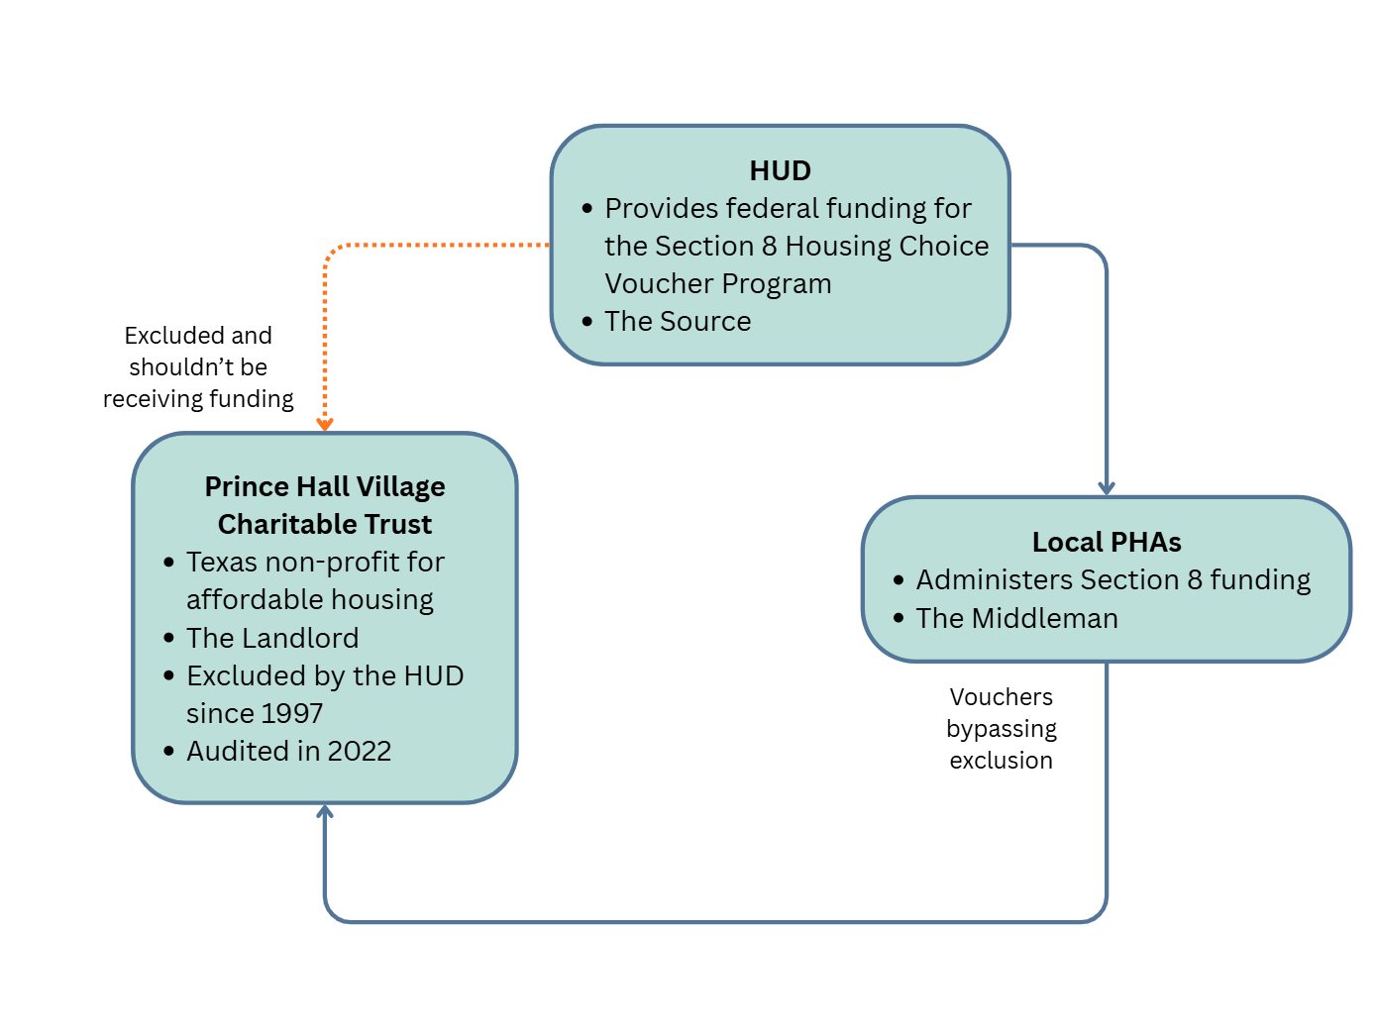
A Gap in the System
How HUD Paid an Excluded Entity for 28 Years
Key Players
What Went Wrong
The Gap
2 CFR § 180.300: Requires checking exclusion status before covered transactions.
Agencies are required to verify an entity isn't excluded before entering transactions.
Prince Hall was excluded by HUD in 1997. Section 8 payments were not screened.
PHAs relied on manual checks
Exclusion enforcement failed across decentralized systems
~$2M paid in Section 8 subsidies
Payments confirmed through 2022 audit activity
Failure persisted for 28 years
Without automated, pre-payment exclusion screening, permanent exclusions can be effectively ignored, even within a single agency.
A glaring intra-agency oversight
Clean audits don't reveal exclusion status. Data must be integrated.
Undermines federal payment integrity and public trust.
Creates legal, financial, and reputational risk.
Fiscal Patriots | AGA Datathon 2026
Source: SAM.gov Public Extract 25361 (Dec 27, 2025) | FAC (FY2016-2024) | USAspending.gov (FY2019-2024) | 2 CFR § 180.300
Notes:
Nikita
Next, lets take a look at what happens when exclusions are not enforced at the point of payment.
The U.S. Department of Housing and Urban Development runs several programs that fund affordable housing. One of the largest is the Housing Choice Voucher Program, commonly known as Section 8. Under this program, low-income tenants receive vouchers that cover part of their rent. The federal government funds those subsidies, but local Public Housing Agencies, or PHAs, actually send the payments directly to landlords every month.
Separately, HUD has the authority to exclude entities from participating in its programs. Once an entity is excluded, it is no longer eligible to receive federal funds from HUD.
Prince Hall Village Charitable Trust was a housing development in Texas that was permanently excluded by HUD in 1997. That exclusion was indefinite and remains active today.
Despite this, the organization continued receiving Section 8 Housing Choice Voucher payments through at least 2022, totaling approximately two million dollars in federal funds over 28 years. This was discovered during an audit when the property was sold to a 3rd party.
So, what went wrong?
This case is unique in the data. Out of all entities in the federal audit and exclusion datasets, this is the only one that meets all of these conditions, which makes it a clear, verified failure. However, the Prince Hall Charitable Trust was one of the 28% of entities traceable in the data. There could be more cases hidden in unrecorded transactions.
The Data is there, but the connections aren’t. Without traceability the system leaves room for inter-agency oversight, undermining federal payment integrity and public trust.

Slide 15
Banned by One Agency, Paid by Another
Cross-Agency Communication Failure
What Went Wrong
Key Legal Principles
Why This Matters
Entity: Amerihost Services, LLC
Excluded by EPA: September 8, 2021
Problem: Despite the EPA ban, HUD continued paying the entity for housing-related awards in FY2022–FY2024.
Entity had no Single Audit
2 CFR § 180.100: Federal exclusions are binding across all agencies.
An exclusion by one agency (EPA) automatically applies to all other federal agencies, including HUD.
This is known as government-wide reciprocal effect.
2 CFR § 180.415(b)
Agencies cannot renew or extend transactions with an excluded entity unless an exception is documented.
15 payments over FY2022–FY2024 (5 per year) constitute renewals or extensions, prohibited without an exception.
HUD paid $759,584 over 15 payments to a legally excluded entity.
Cross-agency enforcement gaps
Lack of automated screening for exclusions
Direct legal violations of federal regulations
HUD paid a legally excluded entity, creating a cross-agency compliance failure.
Connected by UEI Unique Entity Identifier
Fiscal Patriots | AGA Datathon 2026
Source: SAM.gov Public Extract 25361 (Dec 27, 2025) | USAspending.gov (FY2019-2024) | 2 CFR § 180.100, § 180.415(b)
Notes:
Nikita
This second case expands the problem beyond a single agency and shows why this is a government-wide issue.
Amerihost Services is a landlord that participates in federally assisted housing programs. On September 8, 2021, Amerihost was formally excluded by the Environmental Protection Agency, or EPA.
Under federal law, exclusions are not agency-specific. The governing regulation, 2 CFR Part 180, establishes what is called government-wide reciprocity. This means that when one federal agency excludes an entity, all federal agencies are legally required to honor that exclusion.
In other words, once the EPA excluded Amerihost, HUD was prohibited from making any new awards, renewals, or extensions involving that entity unless a formal exception was documented.
Despite this, HUD-funded housing assistance payments continued. Specifically:
Five separate awards were made each year
Across fiscal years 2022, 2023, and 2024
Totaling approximately $760,000 across fifteen payments
These payments are not one-time errors. Each year’s payments represent a renewal or continuation of assistance, which federal regulations explicitly prohibit when an entity is excluded.
Again, the exclusion data was visible, but enforcement fell short because it depended on manual checks rather than an automated system.

Slide 16
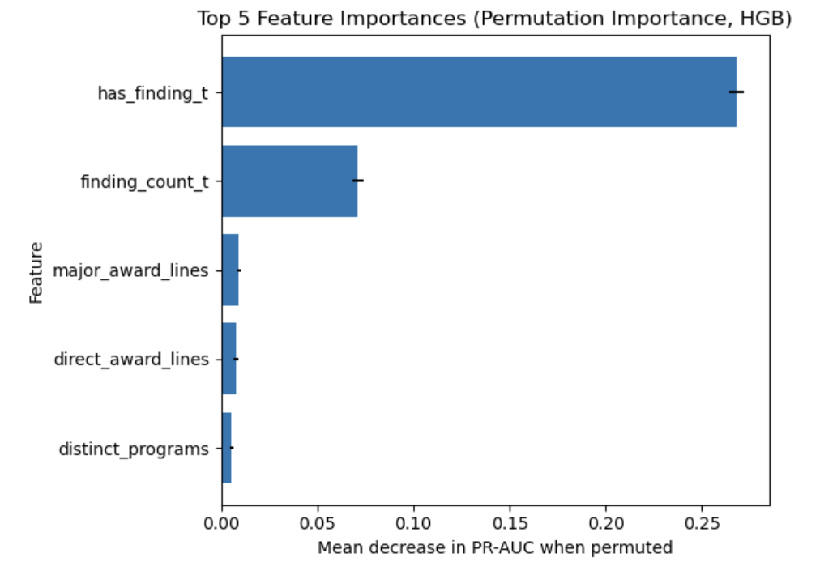
Predicting Audit Findings (Entity-Year Risk Model)
Notes for Pranavi:
Altering model to predict material weakness specifically?
How can the model be used to predict whether a specific entity will have findings the next year?
Expand training to include up to 2022 (make testing 2023
Predict whether a federal grant recipient will have audit findings next year using prior-year audit + funding characteristics to support risk oversight.
Model
Performance
Algorithm: HistGradientBoosting (HGB) classifier
Unit of Prediction: Entity-year (recipient in year t → predicts findings in t+1)
Inputs: prior findings indicators/counts, award line counts, funding totals/mix, program & agency diversity
ROC-AUC: 0.7656
PR-AUC: 0.5439
Key Signals
Prior finding flag / finding count
Award-line volume (# of direct award lines)
Breadth of funding (distinct programs/agencies
Scale of funding (program totals / major award lines)
Fiscal Patriots | AGA Datathon 2026
Source: FAC (AY2019-2022)
Notes:
So far, we've done a deep dive on the facts in the present. But what about looking into the future?
With this model, we've created an early warning signal for which organizations are more likely to have audit findings next year, based on what we already know about them today.
The main use case here is helping prioritize where to focus attention, outreach, or support to entities. It’s important to say upfront: this model does not decide that someone ‘will’ have findings. It’s a risk indicator for oversight, not a judgment.
In terms of how it works, the model looks at each recipient in a given year. So think of it as an ‘entity-year’ snapshot --and then predicts whether that recipient will have findings in the following year. It uses information we already have, like whether there were findings previously, how many findings there were, and patterns in funding like how many award lines they have, how broad their funding is across programs and agencies, and overall funding scale.
The algorithm we chose is called a HistGradientBoosting model, or HGB.
The machine learning math behind it may be complex, but what matters is that it’s very good at spotting patterns and combinations of factors that relate to future risk, without us having to manually write a bunch of rules.
To evaluate performance of an ML model, we use two standard measures.
The first is ROC-AUC, where higher is better, and our score is 0.7656. Essentially, this tells us that if you randomly pick one entity-year that will have findings next year and one that won’t, the model will assign a higher risk score to the “will have findings” case about 77% of the time. The second is PR-AUC, which is especially helpful when the outcome is relatively uncommon (like audit findings ) and our PR-AUC is 0.5439. In plain language: the model does a solid job distinguishing higher-risk recipients from lower-risk recipients, even when findings are not happening for everyone.
We also want the model to be explainable, not a black box.
So we looked at the strongest signals it uses, shown in the bar plot explaining the importance of each feature in the model. The biggest ones are: whether an entity has had findings before, the number of findings, the volume of award activity (like the number of award lines) and how complex their funding looks, such as being spread across many programs or agencies. These aren’t ‘good’ or ‘bad’ traits ; just patterns that historically tend to correlate with higher likelihood of future findings.
Finally, here’s how we recommend using the output.
Instead of treating this as just a score, we can use it to create practical oversight triggers. For example, if the model predicts elevated risk, we can establish funding review triggers—meaning certain awards may get an added check, added documentation, or an extra level of review before moving forward.
Second, for entities with repeat findings, we recommend making a risk model check a standard step in the workflow before reviewing or approving new awards. This doesn’t mean automatically stopping funding—it simply ensures we’re being intentional and consistent about how we review higher-risk cases.
Overall, the value here is that the model supports smarter oversight. It helps teams focus limited time and attention where it’s most needed, reducing administrative inefficiencies, while keeping the final decision with policy, auditors, and program staff.
Its important to note that this model is not causal , so we can’t say the model found the ‘reason’ for findings - only patterns that predict risk. It also depends on data quality and reporting consistency. That’s why we’d monitor performance over time, watch for changes in the data, and retrain or recalibrate as needed

Slide 17
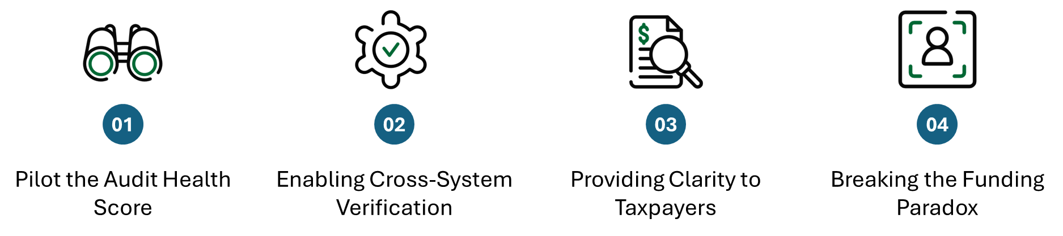
Closing the Gaps
From analysis to accountability.
OMB / Treasury
OMB / Agencies
Treasury
OMB / Awarding Agencies
Connected by UEI Unique Entity Identifier
The Bottom Line: The data exists. The tools exist. What's missing is the integration.
Fiscal Patriots | AGA Datathon 2026
Source: USAspending.gov (FY2019-2024), FAC (FY2016-2024), SAM.gov Public Extract 25361 (Dec 27, 2025) | 2 CFR 200 | DATA Act
Notes:
Pranavi
4 Main Recommendations:
Pilot the Taxpayer Protection Score
Test Taxpayer Protection score with select awarding agencies
Provides public-facing risk visibility before award decisions
Enable Cross-System Verification
Automate pre-payment exclusion screening
Eliminating reliance on error-prone manual checks
Providing Clarity to Taxpayers
Explore risk or trust scoring with the TPS within USAspending.gov
Addressing the use case of increasing engagement with government focused data-sets and financial literacy
Addressing the Funding Paradox (slide 12)
Callback to slide 12 where higher risk entities receive more money
Require risk review before renewing awards to entities with repeat findings
Establish funding triggers when audit findings exceed threshold
And of course for all of these recommendations to work, the Office of Management and Budget would be crucial here, need to release guidance that sets the requirement and agencies can implement said guidance
-What lead agency would be taking on each recommendation

Slide 18
Appendix
Action needed, need to confirm with Khaled/Pranavi: ML training dataset build workflow: confirm workflow + artifacts
Train/test split method used model validation metrics to report and final values
Filenames for "final ml-ready outputs bullet point in ML model section
DATA SOURCES
TAXPAYER PROTECTION SCORE
REGULATORY CITATIONS
USAspending.gov: API docs + data dictionary
Federal Audit Clearinghouse (FAC): dataset overview + files used
SAM.gov Exclusions: public extract documentation (UEI coverage limitation)
"Allowable Data Sources " (competition rules screenshot / doc)
Data dictionaries used in this repo (FAC, USAspending, Merged outputs)
Variable Definitions (fields used in scoring)
Weighting rationale (risk factors vs mitigating factors)
Score formula and tier thresholds
"Problem Entity" rule (logic and flags)
GAO-05-479 (2005) reference used
GAO-09-174 (2009) reference used
2 CFR 200 Subpart F references(audit requirements)
METHODOLOGY
ML MODEL
CASE STUDIES (EXTENDED)
Pipeline overview (Clean --> Score --> Merge) visual
Join logic: UEI mapping (auditee_uei = recipient_uei) explanation
Alteryx workflows (screenshots + the .yxmd files)
Data acquisition notes (what we downloaded, and why)
ML training dataset build workflow
Train/test split methodology
Feature list + feature importance chart (or placeholder if not done
Model validation metrics
Final ML-ready outputs
Full audit findings for flagged entities
Supporting documentation: screenshots/tables used in the write-up
Fiscal Patriots | AGA Datathon 2026
Notes:
Andy
# Objective: Build an entity-year (EIN-based) panel from FAC audit and federal award data (2019–2022)
# to predict whether a federal grant recipient will have audit findings in the next audit year (t+1),
# and explain key drivers of risk using permutation importance and SHAP.
#Tech Stack (Python): Tech stack (Python): pandas, NumPy, scikit-learn, SHAP
#Data Sources: FAC general, awards, and findings data from 2019, 2020, 2021, and 2022

Slide 19
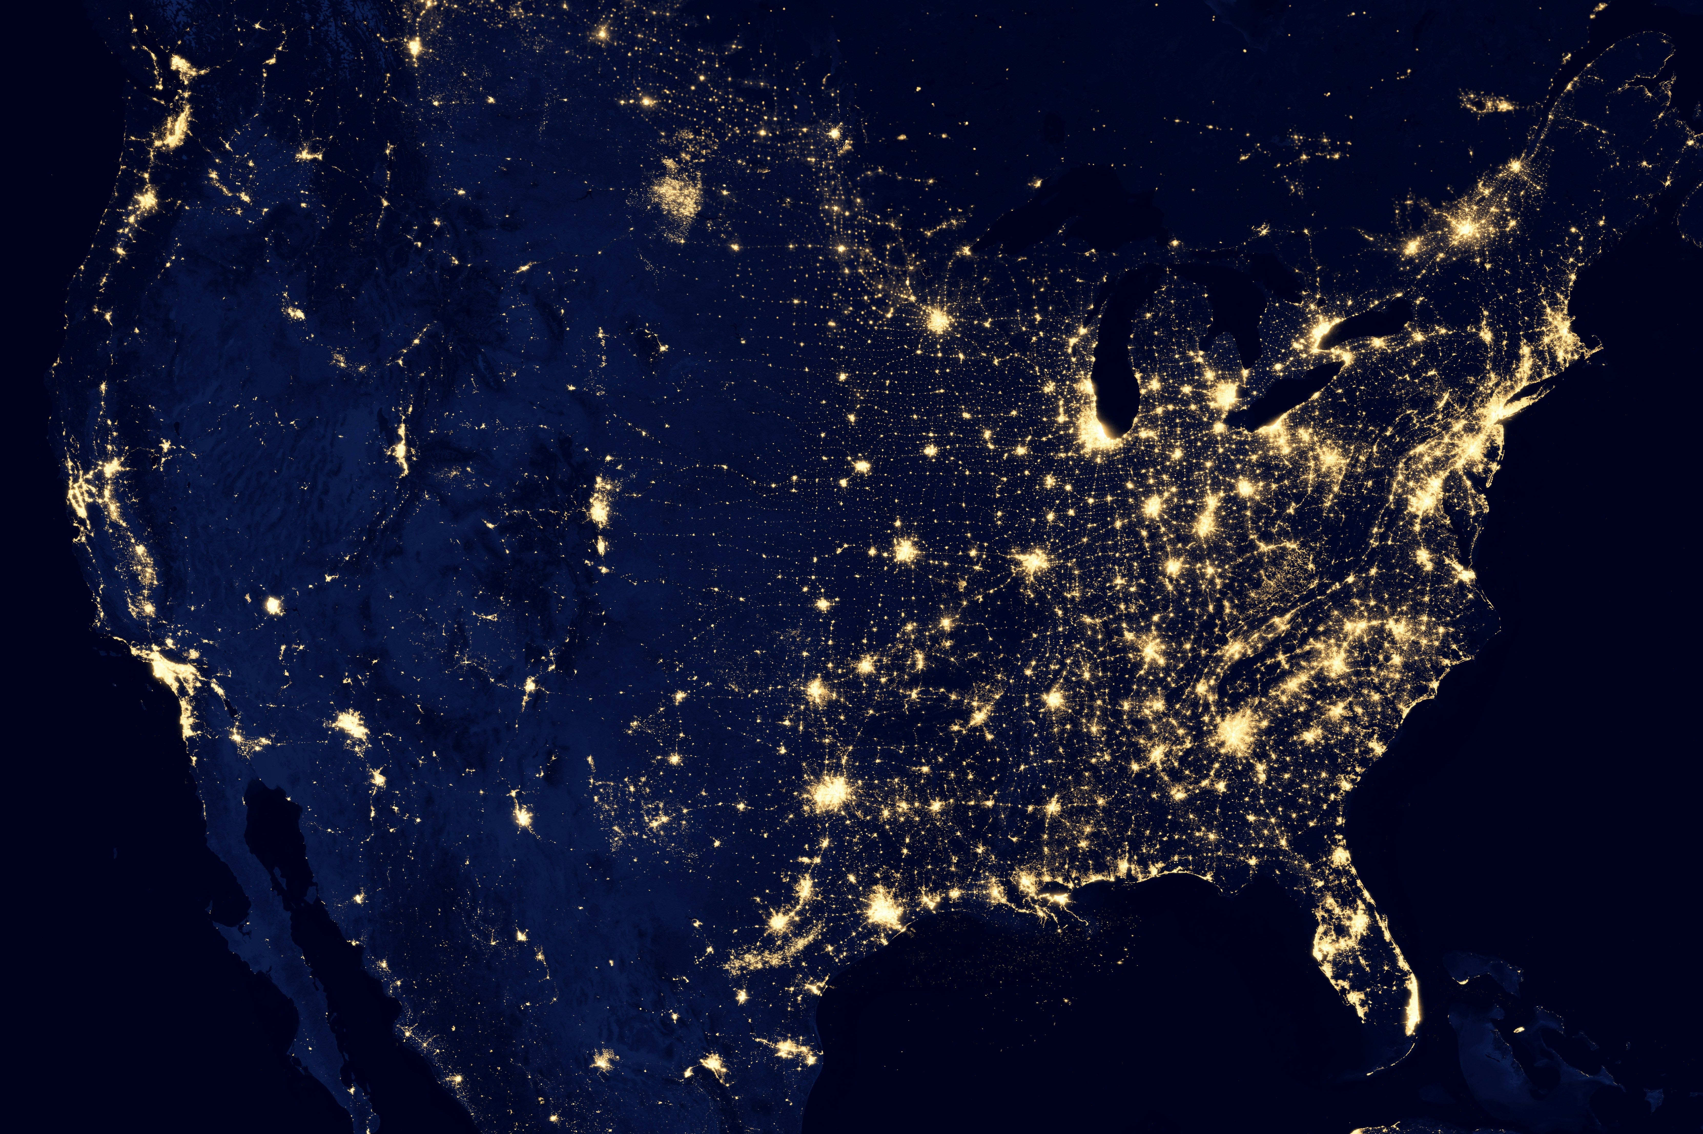
Thank you

Slide 20

Closing the Gap - Recommendations
01
Closing the 72% Blind Spot
Require UEIs for all SAM exclusion records
Retroactively assign UEIs where feasible
02
Enabling Cross-System Verification
Automate pre-payment exclusion screening
Eliminate reliance on error-prone manual checks
03
Providing Clarity to Decision-makers and Tax-payers
Display audit history to awarding officials
Explore risk or trust scoring within USAspending.gov
Taxpayer Protection Score
Public-facing indicator for entity health
Audit Finding Risk Model
Highlights entities needing further research before funding
The Bottom Line: Funding Data needs to provide exclusion visibility to multiple stakeholders in the system. This is where trust scores become essential in decision-making and transparency.
Connected by UEI Unique Entity Identifier
Fiscal Patriots | AGA Datathon 2026
Source: USAspending.gov (FY2019-2024), FAC (FY2016-2024), SAM.gov Public Extract 25361 (Dec 27, 2025)
Notes:
Pranavi

